Slide 1

Algorithms and Data Structures 2 CS 1501
Spring 2022
Sherif Khattab
ksm73@pitt.edu
(Slides are adapted from Dr. Ramirez’s and Dr. Farnan’s CS1501 slides.)

Slide 2
Announcements
Upcoming deadlines:
Assignment 1 due on 3/14
Homework 7 due on 3/14
Lab 7 due on 3/18
Assignment 2 due on 3/28 (posted tonight)

Slide 3
Previous lecture …
Single-pass fixed-codeword-size Compression
LZW compression and expansion

Slide 4
CourseMIRROR Reflections (Interesting)
The variety of different compression algorithms and their advantages was most interesting in today’s class.
Going through examples of LZW compression
Stepping through the LZW algorithm and thinking about how to store and extract as a data structure
creating the code book during LWZ expansion
How tries and sorted arrays are similar
I found it interesting how LZW changes the bit size of the codewords
The LZW examples were interesting to work through. (The quick reference to Weissman Score was funny, good to know.)
I thought the test was pretty fair, not overly challenging
The multiple questions for low points is nice to ensure a decent grade

Slide 5
CourseMIRROR Reflections (Confusing)
The general approach to the LZW compression algorithm today was most confusing.
the LWZ corner case
Lzw and how a table is created
i would like to review when to use LZW and when to use Huffman
Im not sure I understand decoding using LZW for the case when the codeword is not in the codebook
Please update the slide on GitHub before the lecture
The test wasn’t awful, most difficult part being the LZW
The true/false Java problem about the PHP Array (Lab6) runtime frequency analysis
Some questions on the exam were confusing.

Slide 6
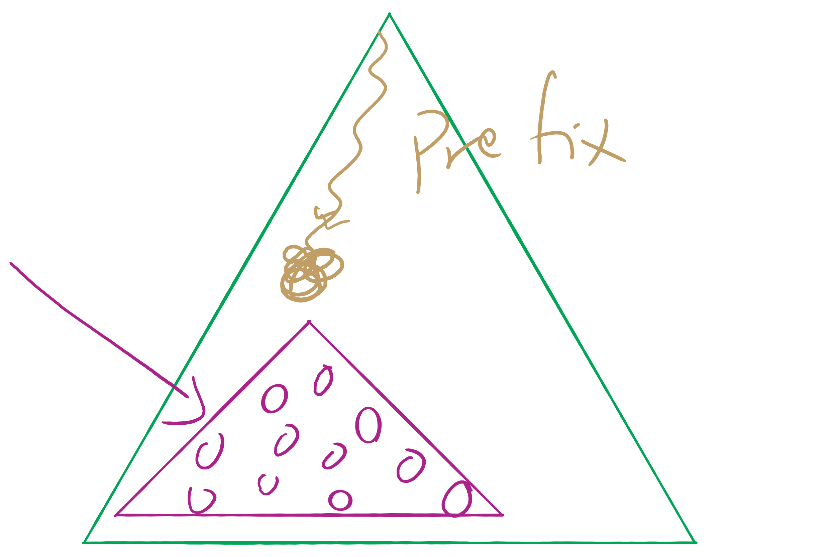
Assignment 1 runtime analysis

Slide 7
Problem of the Day
Input: A file containing LinkedIn Connection information formatted like the following:
Account1: Connection1, Connection2, …
Account2: Connection1, Connection2, …
…
Output: Answer the following questions:
Given two LI accounts, how “far” are they from each other?
E.g., 1st connection, 2nd connection, etc.
Are the accounts in the file all connected?
If not, how many connected components are there?
Are there certain accounts that if removed, the remaining accounts become partitioned?
These account are called articulation points

Slide 8
Which Data Structure to use?
Let’s think first about how to structure the data that we have in memory.
Account1: Connection1, Connection2, …
Account2: Connection1, Connection2, …
…

Slide 9
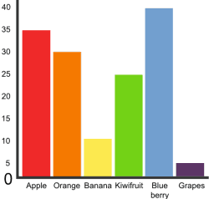
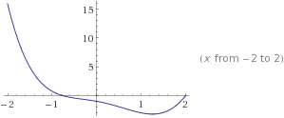
Graphs!
5
3
4
0
2
1

Slide 10
Graphs
A graph G = (V, E)
Where V is a set of vertices
E is a set of edges connecting vertex pairs
Example:
V = {0, 1, 2, 3, 4, 5}
E = {(0, 1), (0, 4), (1, 2), (1, 4), (2, 3), (3, 4), (3, 5)}
5
3
4
0
2
1

Slide 11
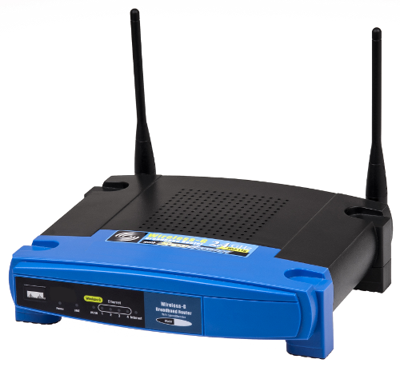

Why?
Can be used to model many different scenarios

Slide 12
Some definitions
Undirected graph
Edges are unordered pairs: (A, B) == (B, A)
Directed graph
Edges are ordered pairs: (A, B) != (B, A)
Adjacent vertices, or neighbors
Vertices connected by an edge

Slide 13
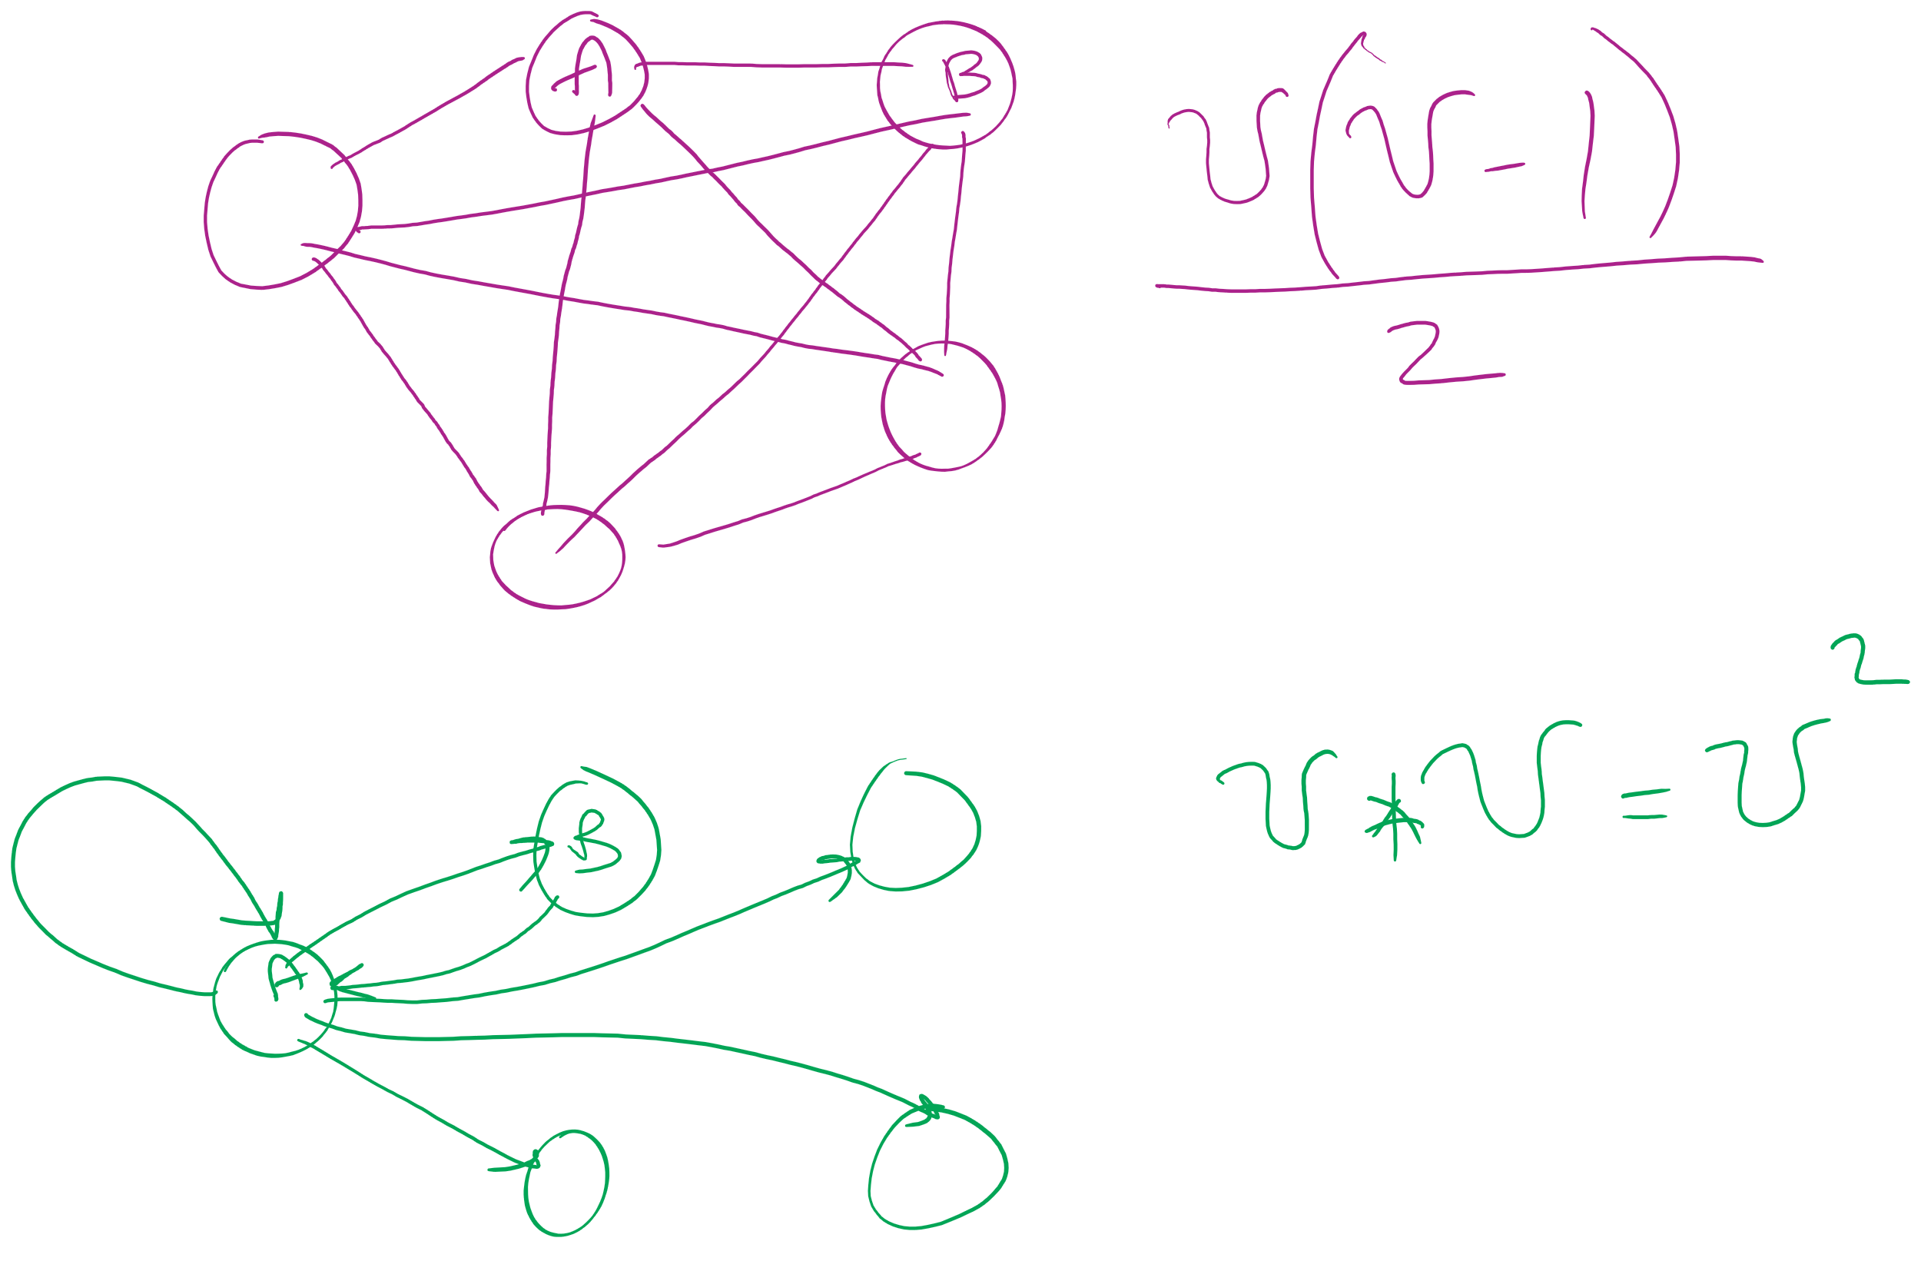
Graph sizes
Let v = |V|, and e = |E|
Given v, what are the minimum/maximum sizes of e?
Minimum value of e?
Definition doesn’t necessitate that there are any edges…
So, 0
Maximum of e?
Depends…
Are self edges allowed?
Directed graph or undirected graph?
In this class, we'll assume directed graphs have self edges while undirected graphs do not
Notes:
directed (w/ self edges)
v vertices each with edges to v vertices
v²
undirected (no self edges)
v vertices with edges to v-1 vertices
BUT remember for undirected, (1, 2) == (2, 1)
v(v - 1) / 2
(v² - v) / 2

Slide 14
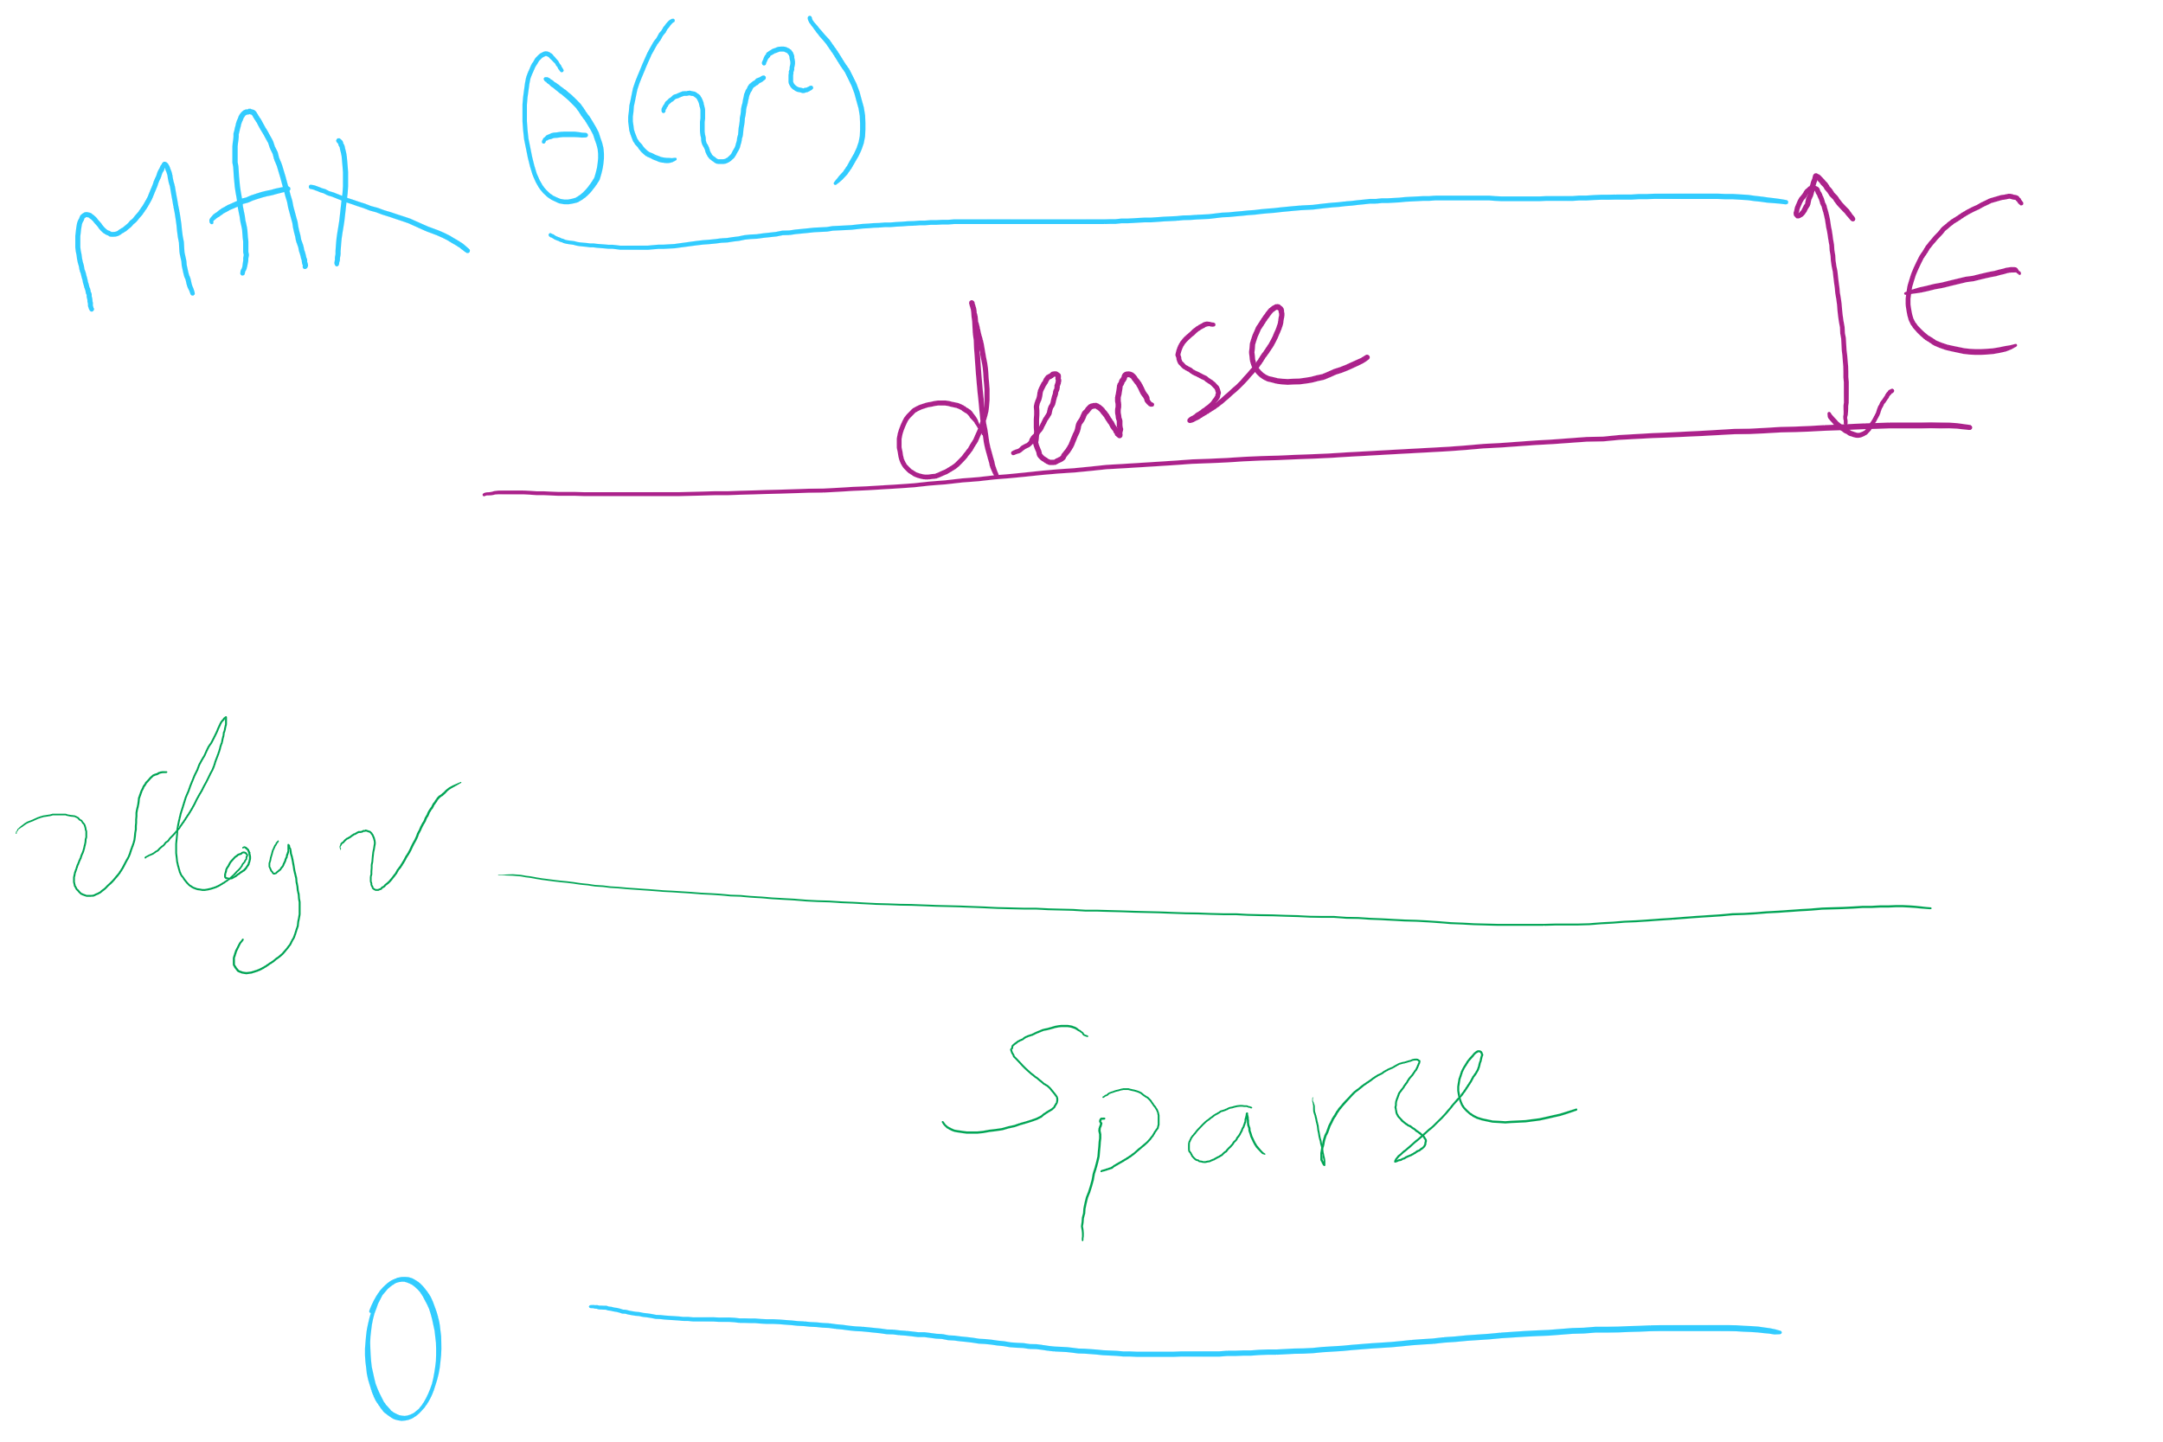
More definitions
A graph is considered sparse if:
e <= v lg v
A graph is considered dense as it approaches the maximum number of edges
I.e., e == MAX - ε
A complete graph has the maximum number of edges
Notes:
v² - ε for directed
((v² - v) / 2) - ε for undirected
Have we seen “sparse” and dense before?
yes -- with tries, for sparse tries DLB is better; for dense, R-way tries are better

Slide 15
Question:
5
5
==
or
!=
3
4
4
3
0
0
2
1
1
2
?
Notes:
Different spatial representations of the same vertices/edges are considered the same graph

Slide 16
Representing graphs
Trivially, graphs can be represented as:
List of vertices
List of edges
Performance?
Assume we're going to be analyzing static graphs
I.e., no insert and remove
So what operations should we consider?
Notes:
We haven’t talked about problems to solve yet, but can you imagine tasks you might want to do with graphs?

Slide 17
Using an adjacency matrix
Rows/columns are vertex labels
M[i][j] = 1 if (i, j) ∈ E
M[i][j] = 0 if (i, j) ∉ E
 | 0 | 1 | 2 | 3 | 4 | 5
0 | 0 | 1 | 0 | 0 | 1 | 0
1 | 1 | 0 | 1 | 0 | 1 | 0
2 | 0 | 1 | 0 | 1 | 0 | 0
3 | 0 | 0 | 1 | 0 | 1 | 1
4 | 1 | 1 | 0 | 1 | 0 | 0
5 | 0 | 0 | 0 | 1 | 0 | 0

Slide 18
Adjacency matrix analysis
Runtime?
Space?
Notes:
Time:
Check edge existence in Θ(1)
Θ(v) to find the neighbors of a vertex
Θ(v²) time to initialize
Space:
Θ(v²) memory
Regardless of |E|

Slide 19
Adjacency lists
Array of neighbor lists
A[i] contains a list of the neighbors of vertex i
0
1
2
3
4
5
1
0
1
2
0
3
4
2
3
4
1
4
5
3

Slide 20
Adjacency list analysis
Runtime?
Space?
Notes:
Time:
Θ(d) to check edge existence/find the neighbors of a vertex
Where d is the degree of a vertex
# of neighbors
Can be up to Θ(v) to check edge existence/find the neighbors of a vertex
Space:
Θ(v + e) memory
Plus overhead of node use
Could be much less than v²

Slide 21
Comparison
Where would we want to use adjacency lists vs adjacency matrices?
What about the list of vertices/list of edges approach?
Notes:
Adjacency matrix is better for dense graphs
Adjacency list is better for sparse graphs
Lists approach is bad
Aside from not storing redundant edge info for undirected graphs, worse than adj list

Slide 22
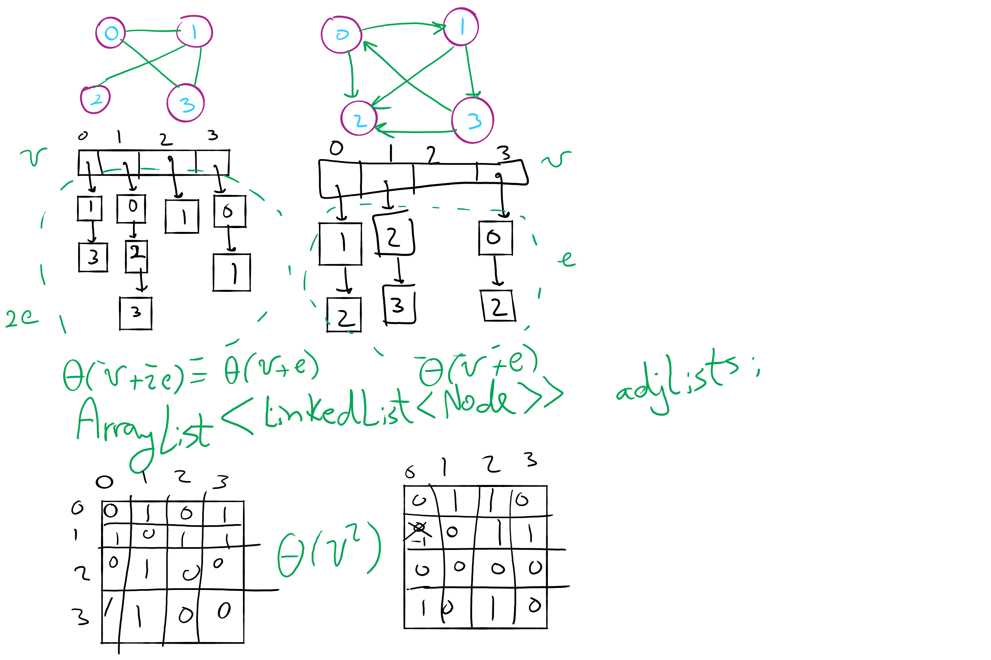
Graph Representation Example 2

Slide 23
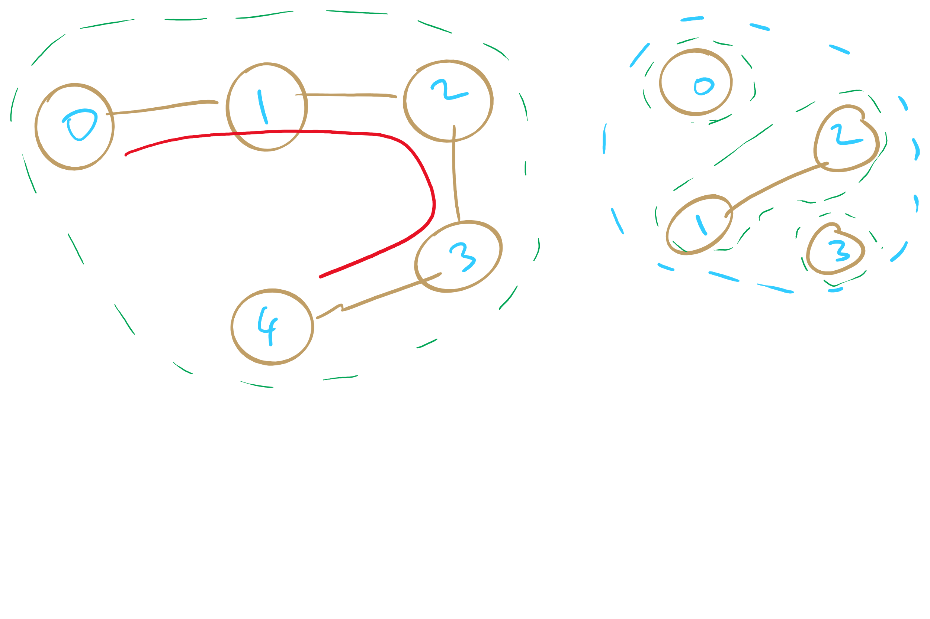
Sparse Graphs

Slide 24
Comparison
Where would we want to use adjacency lists vs adjacency matrices?
What about the list of vertices/list of edges approach?
Notes:
Adjacency matrix is better for dense graphs
Adjacency list is better for sparse graphs
Lists approach is bad
Aside from not storing redundant edge info for undirected graphs, worse than adj list

Slide 25
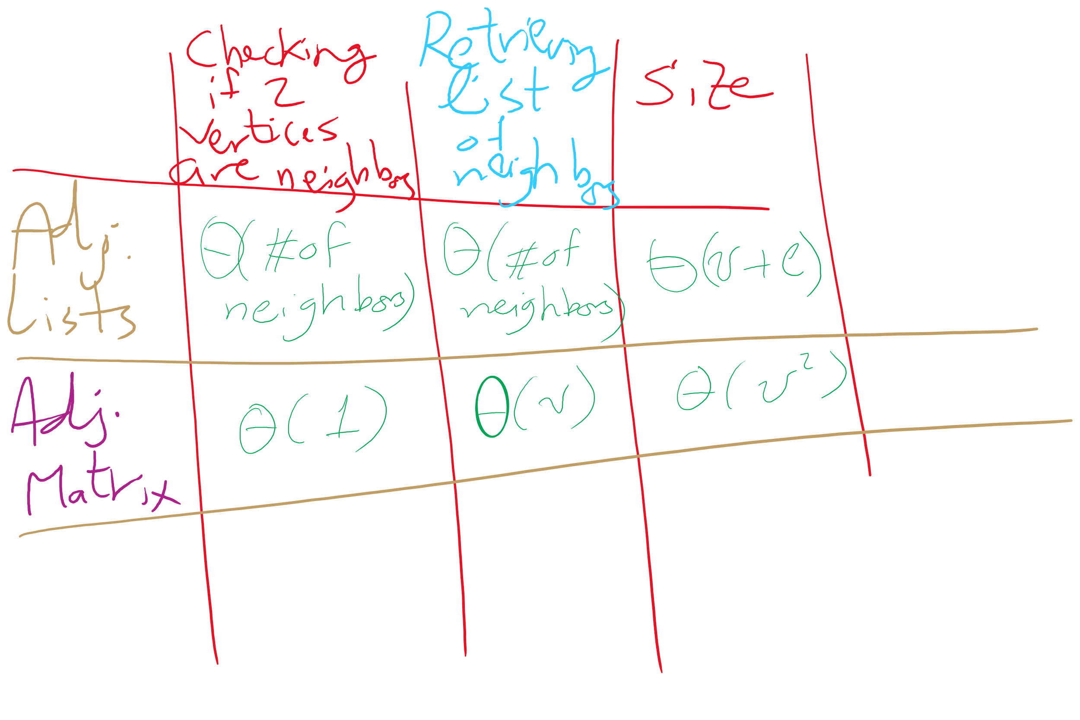
Adjacency Matrix vs. Adjacency Lists

Slide 26
Even more definitions
Path
A sequence of adjacent vertices
Simple Path
A path in which no vertices are repeated
Simple Cycle
A simple path with the same first and last vertex
Connected Graph
A graph in which a path exists between all vertex pairs
Connected Component
Connected subgraph of a graph
Acyclic Graph
A graph with no cycles
Tree
?
A connected, acyclic graph
Has exactly v-1 edges
Notes:
Difference between Connected graph and Complete graph?
Connected means there is a path from vertA to vertB
Complete means maximum number of edges in graph (so, vertA has edge to vertB)

Slide 27
Graph traversal
What is the best order to traverse a graph?
Two primary approaches:
Breadth-first search (BFS)
Search all directions evenly
I.e., from i, visit all of i’s neighbors, then all of their neighbors, etc.
Would help us compute the distance between two vertices
Remember our problem of the day?
Depth-first search (DFS)
“Dive” as deep as possible into the graph first
Branch when necessary
Would help us find articulation points
Remember our problem of the day?

Slide 28
BFS
Can be easily implemented using a queue
For each vertex visited, add all of its neighbors to the Q (if not previously added)
Vertices that have been seen (i.e., added to the Q) but not yet visited are said to be the fringe
Pop head of the queue to be the next visited vertex
See example

Slide 29
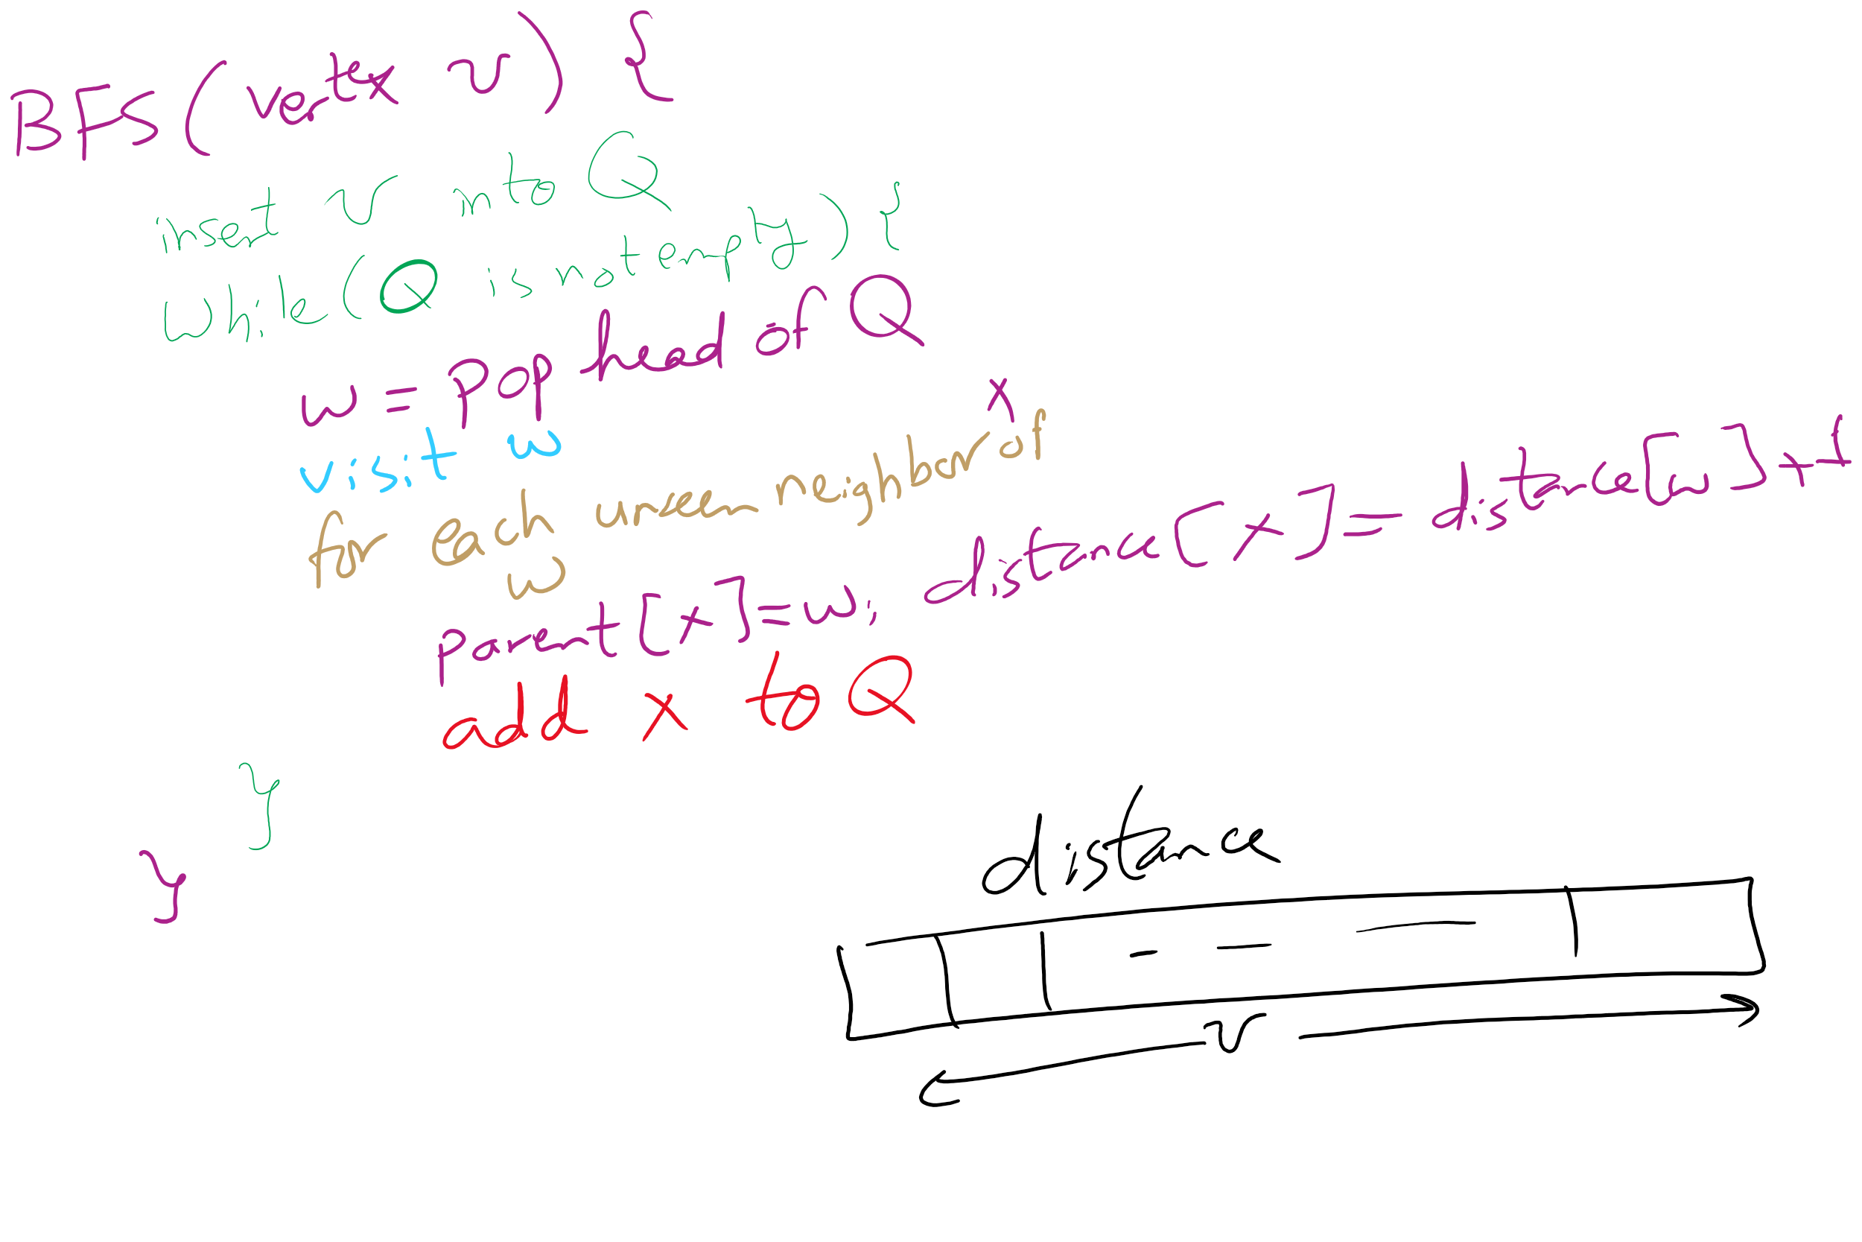
BFS Pseudo-code

Slide 30
BFS example
Q
0
0
1
7
2
1
2
1
2
9
3
3
6
6
3
8
4
5
4
5
4
7
7
5
9
9
6
8
8
Notes:
note that we are building connected, acyclic graphs with both bfs and dfs (will define on next slide)
get students to pick out that we are also doing shortest paths with bfs

Slide 31
Shortest paths
BFS traversals can further be used to determine the shortest path between two vertices

Slide 32
Problem of the Day
Input: A file containing LinkedIn Connection information formatted like the following:
Account1: Connection1, Connection2, …
Account2: Connection1, Connection2, …
…
Output: Answer the following questions:
Given two LI accounts, how “far” are they from each other?
E.g., 1st connection, 2nd connection, etc.
Are the accounts in the file all connected?
If not, how many connected components are there?
Are there certain accounts that if removed, the remaining accounts become partitioned?
These account are called articulation points

Slide 33
Problem of the Day
Input: A file containing LinkedIn Connection information formatted like the following:
Account1: Connection1, Connection2, …
Account2: Connection1, Connection2, …
…
Output: Answer the following questions:
Given two LI accounts, how “far” are they from each other?
E.g., 1st connection, 2nd connection, etc.
Are the accounts in the file all connected?
If not, how many connected components are there?
Are there certain accounts that if removed, the remaining accounts become partitioned?
These account are called articulation points

Slide 34
BFS would be called from a wrapper function
If the graph is connected:
bfs() is called only once and returns a spanning tree
Else:
A loop in the wrapper function will have to continually call bfs() while there are still unseen vertices
Each call will yield a spanning tree for a connected component of the graph

Slide 35
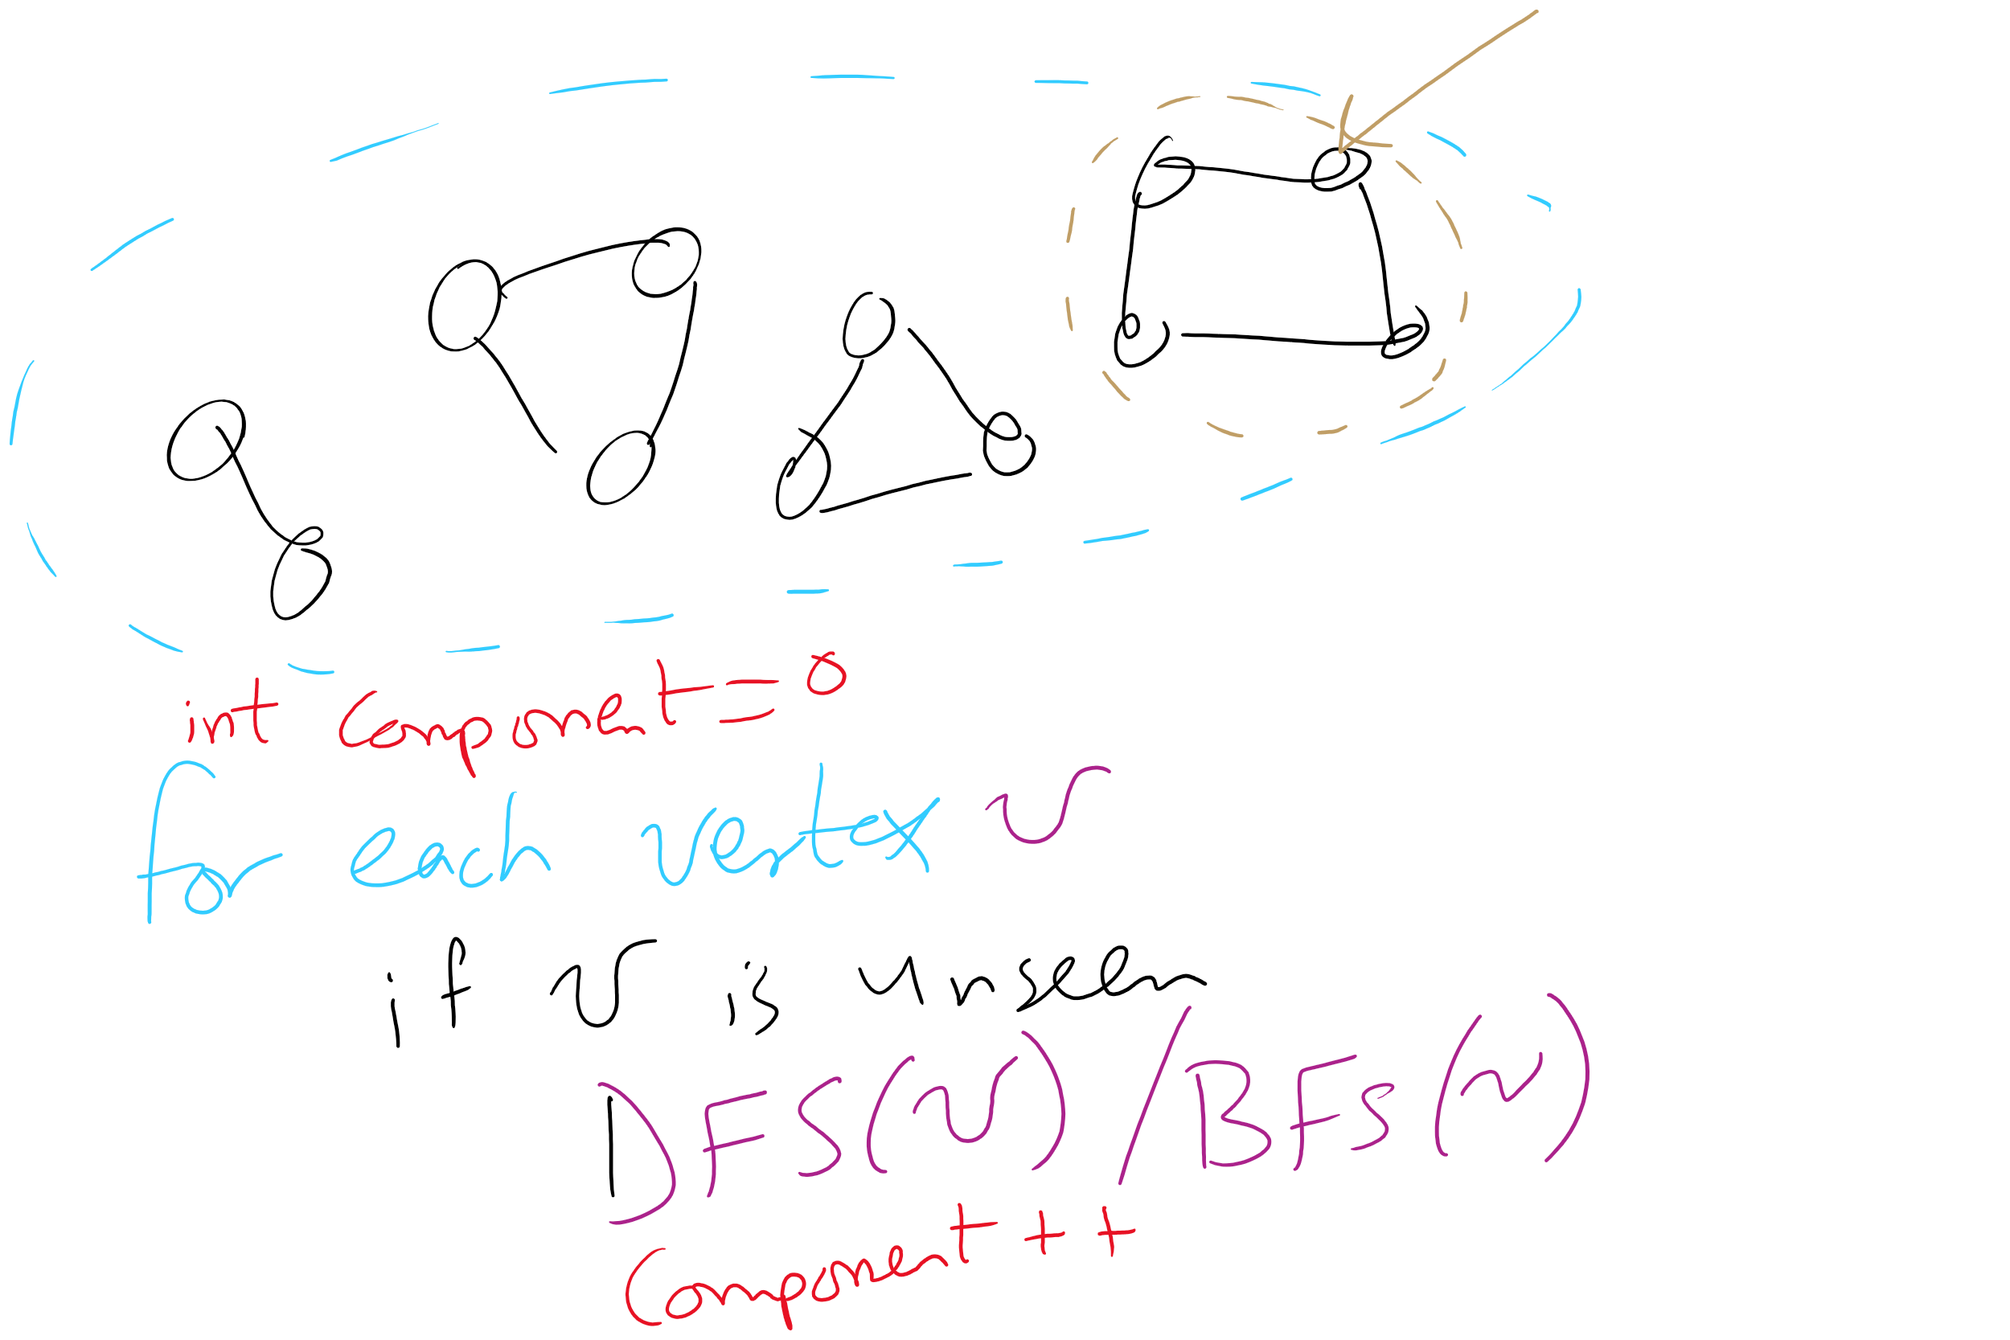
Wrapper function and connected components

Slide 36
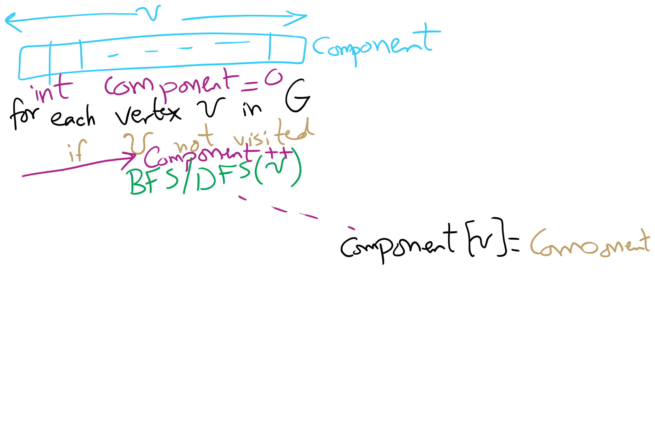
Wrapper function for BFS

Slide 37
Problem of the Day
Input: A file containing LinkedIn Connection information formatted like the following:
Account1: Connection1, Connection2, …
Account2: Connection1, Connection2, …
…
Output: Answer the following questions:
Given two LI accounts, how “far” are they from each other?
E.g., 1st connection, 2nd connection, etc.
Are the accounts in the file all connected?
If not, how many connected components are there?
Are there certain accounts that if removed, the remaining accounts become partitioned?
These account are called articulation points

Slide 38
DFS
Already seen and used this throughout the term
For tries…
For Huffman encoding…
Can be easily implemented recursively
For each vertex, visit first (in some arbitrary order) unseen neighbor
Backtrack at deadends (i.e., vertices with no unseen neighbors)
Try next unseen neighbor after backtracking

Slide 39
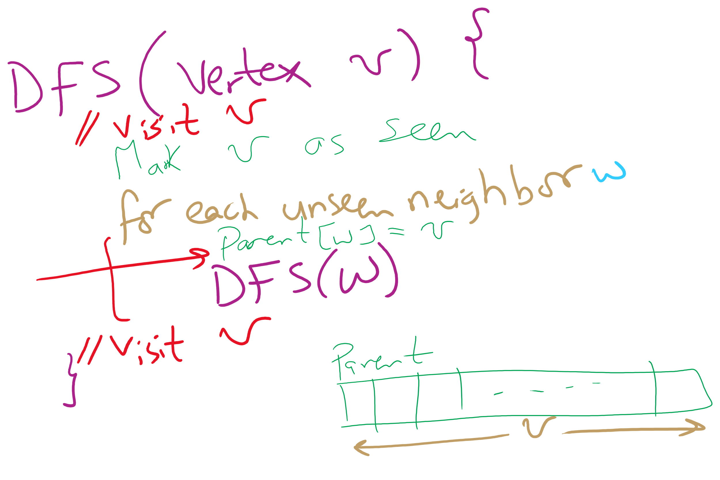
DFS Pseudo-code

Slide 40
DFS example 2
0
0
2
1
2
1
3
3
6
6
4
5
4
5
7
7
9
9
8
8

Slide 41
Analysis of graph traversals
At a high level, DFS and BFS have the same runtime
Each vertex must be seen and then visited, but the order will differ between these two approaches
How will the representation of the graph affect the runtimes of of these traversal algorithms?
Notes:
Adjacency matrix
Θ(v) to consider all neighbors
To traverse a row/column of the matrix
Doing this for each of v vertices leads to Θ(v²) runtime
Adjacency list
Must consider the neighbor list of each vertex in the array
So, we must visit every vertex in the whole adjacency list
Θ(v + e)

Slide 42
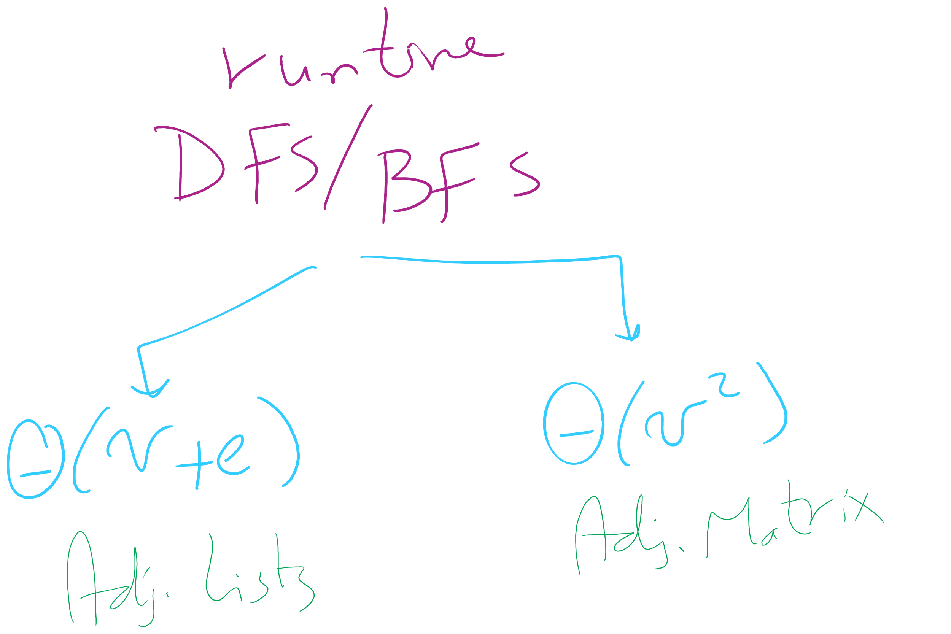
Runtime of BFS/DFS

Slide 43
Biconnected graphs
A biconnected graph has at least 2 distinct paths (no common edges or vertices) between all vertex pairs
Any graph that is not biconnected has one or more articulation points
Vertices, that, if removed, will separate the graph
Any graph that has no articulation points is biconnected
Thus we can determine that a graph is biconnected if we look for, but do not find any articulation points

Slide 44
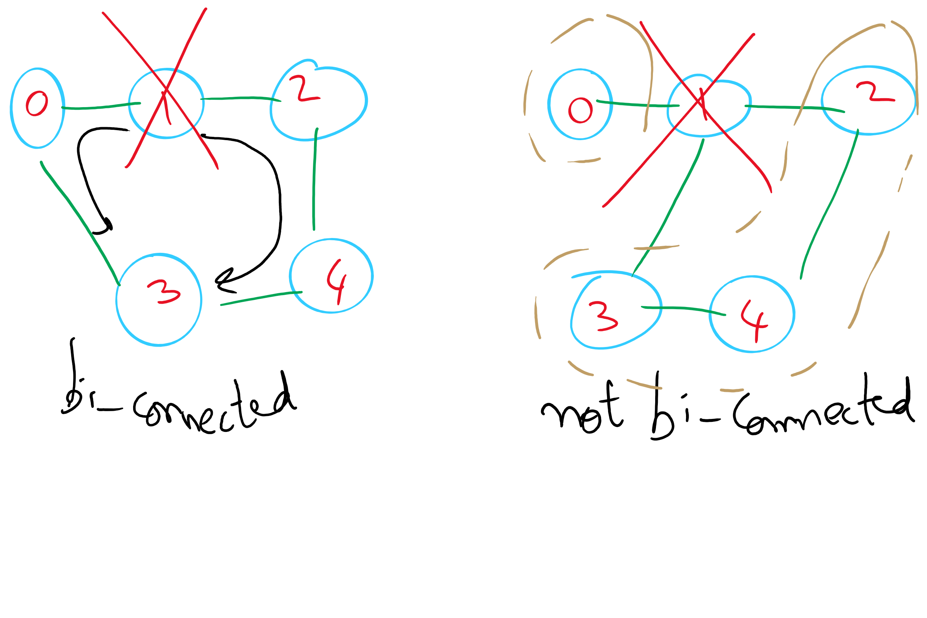
Bi-connected Graph

Slide 45
Finding articulation points
Variation on DFS
Consider building up the spanning tree
Have it be directed
Create “back edges” when considering a vertex that has already been visited in constructing the spanning tree
Label each vertex v with with two numbers:
num(v) = pre-order traversal order
low(v) = lowest-numbered vertex reachable from v using 0 or more spanning tree edges and then at most one back edge
Min of:
num(v)
Lowest num(w) of all back edges (v, w)
Lowest low(w) of all spanning tree edges (v, w)

Slide 46
Finding articulation points example
num
low
0
0
F
E
D
E
1
0
A
A
C
B
2
0
B
3
0
C
4
0
D
5
5
F
Notes:
what type of a traversal do we do to define low() values?
post-order
we're mapping out where there are multiple paths between vertices with back edges
there is a path 4 → 0 → 1 → 2, and 2 → 3 → 4 in this graph
what if we started at 3? how would the result change
root of spanning tree would have 2 children

Slide 47
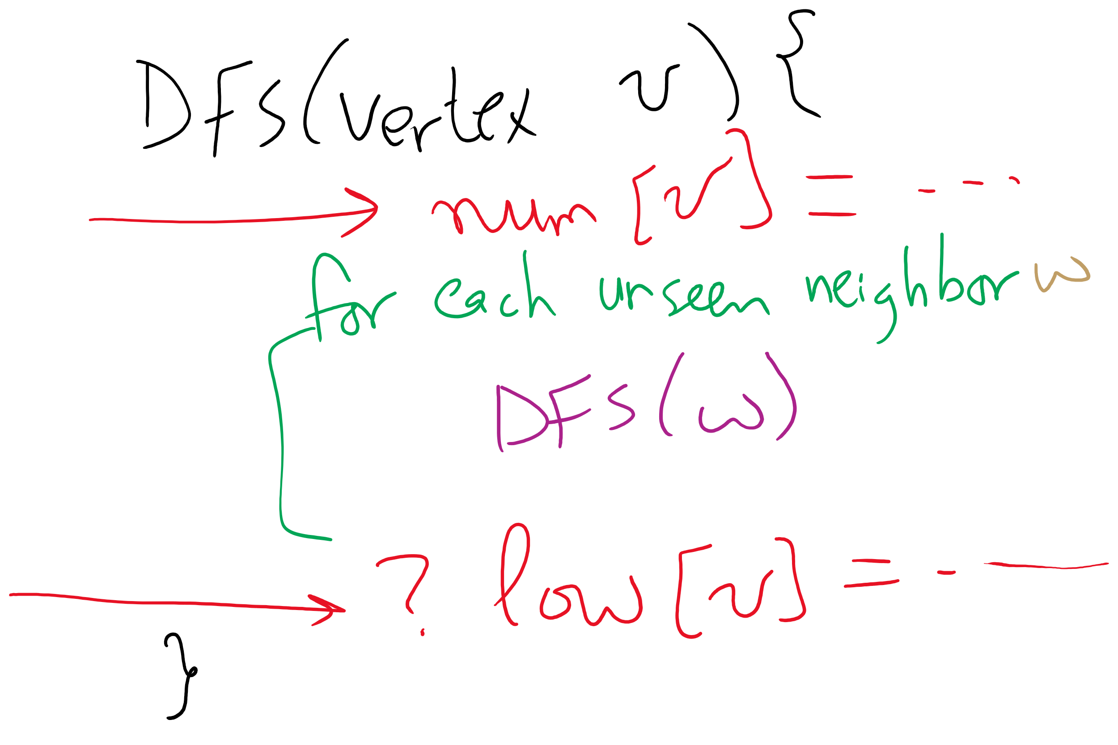
Using DFS to find articulation points

Slide 48
So where are the articulation points?
If any (non-root) vertex v has some child w such that low(w) ≥ num(v), v is an articulation point
What about if we start at an articulation point?
If the root of the spanning tree has more than one child, it is an articulation point
Notes:
does it matter if we add back edges that mirror spanning tree edges (e.g., 3 → 3, or 5 → 3)?
no, because we define low(w) must be less than or equal to num(v)

Slide 49
Problem of the Day
Input: A file containing LinkedIn Connection information formatted like the following:
Account1: Connection1, Connection2, …
Account2: Connection1, Connection2, …
…
Output: Answer the following questions:
Given two LI accounts, how “far” are they from each other?
E.g., 1st connection, 2nd connection, etc.
Are the accounts in the file all connected?
If not, how many connected components are there?
Are there certain accounts that if removed, the remaining accounts become partitioned?
These account are called articulation points

Slide 50
Please submit your reflections by using the CourseMIRROR App
If you are having a problem with CourseMIRROR, please send an email to coursemirror.development@gmail.com
Notes:
All right!
Upcoming Due Dates at A Glance

